Slide 1


MRA Project ML 2
Name: Monica A
Batch: PGPDSBA.O.JUNE22.A
Email: monicaashokac1998@gmail.com

Slide 2
Table of Contents
Exploratory Data Analysis
Inferences of Preliminary Analysis
Data Visualization of Sales using Dynamic Tableau
Data Analysis Inferences
MBA Analysis Using KNIME Analysis
MBA Analysis Work Flow
Inferences on MBA
Recommendations on MBA Analysis
Offers or Combos on MBA Analysis

Slide 3
Problem Statement
A Grocery Store shared the transactional data with you. Your job is to identify the most popular combos that can be suggested to the Grocery Store chain after a thorough analysis of the most commonly occurring sets of items in the customer orders. The Store doesn’t have any combo offers. Can you suggest the best combos & offers?

Slide 4
Exploratory Data Analysis

Slide 5
Primary Data Analysis
We have 20641 rows and 3 columns in the dataset
In the given data, the rows are repeated for a particular Order ID for each item placed.
Date | Order_id | Product
01-01-2018 | 1 | yogurt
01-01-2018 | 1 | pork
01-01-2018 | 1 | sandwich bags
01-01-2018 | 1 | lunch meat
01-01-2018 | 1 | all- purpose
01-01-2018 | 1 | flour
01-01-2018 | 1 | soda
01-01-2018 | 1 | butter
01-01-2018 | 1 | beef
01-01-2018 | 1 | aluminum foil
01-01-2018 | 1 | all- purpose
01-01-2018 | 1 | dinner rolls
01-01-2018 | 1 | shampoo
01-01-2018 | 1 | all- purpose
01-01-2018 | 1 | mixes
01-01-2018 | 1 | soap
01-01-2018 | 1 | laundry detergent
01-01-2018 | 1 | ice cream
01-01-2018 | 1 | dinner rolls

Slide 6
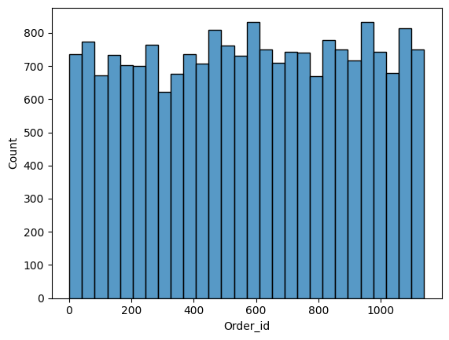
Inferences of Preliminary Analysis
The data follows a normal distribution as shown below.
Previously, we saw that a single order id had multiple rows based on items. This is the reason there are 20641 rows.
The total number of orders placed are 1139 with 37 unique items

Slide 7
Data Visualization of Sales using Dynamic Tableau

Slide 8
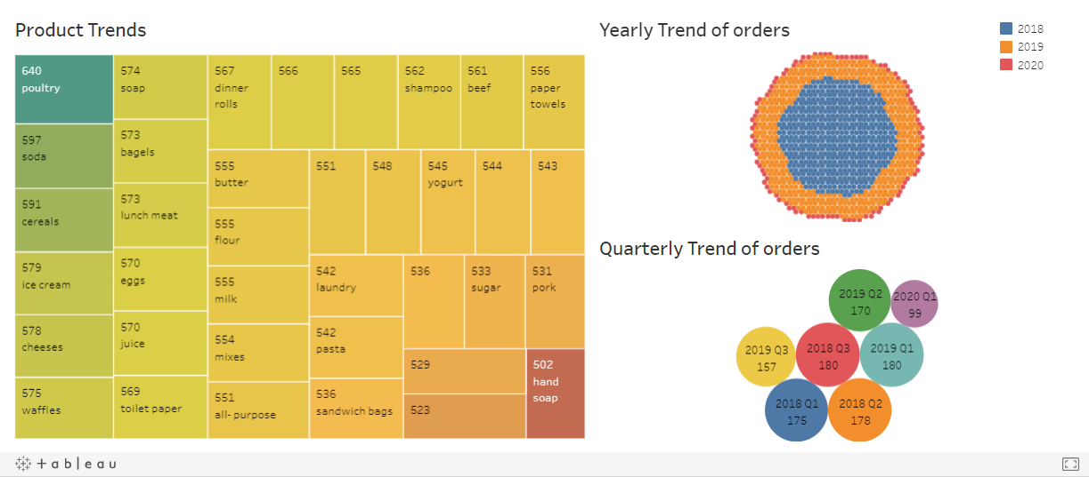
Product and Yearly trends.
The total orders placed in 2018 are 533
The total orders placed in 2019 are 507
Note: All the graphs are embedded from Tableau making the presentation interactive.

Slide 9
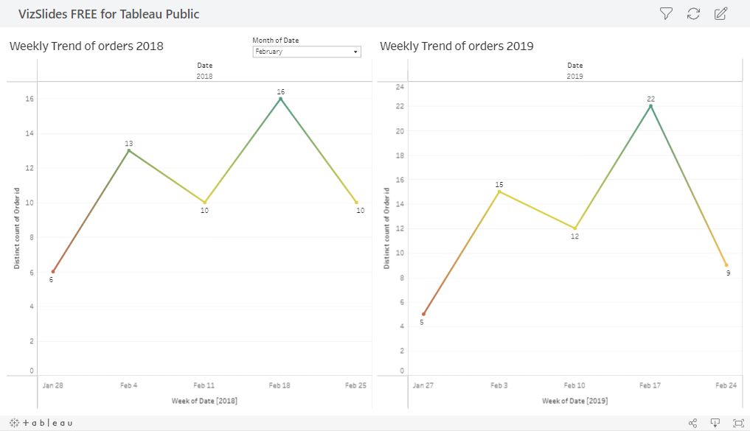
Weekly and Monthly Trends of 2018 and 2019

Slide 10
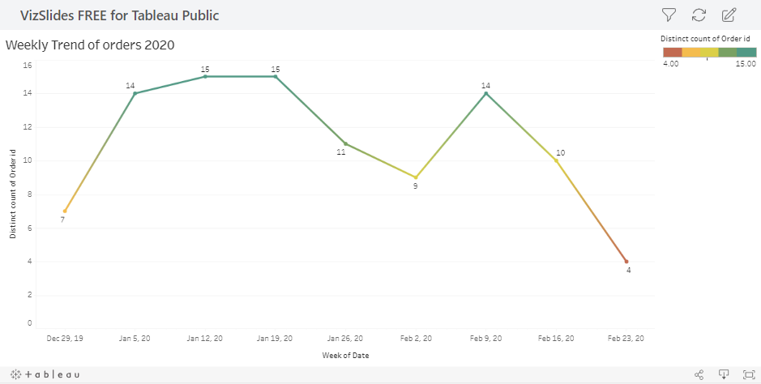
Weekly and Monthly Trends of 2020.
For 2020, we only have first 2 months i.e. January and February Data. The total orders placed in 2020 are 99

Slide 11
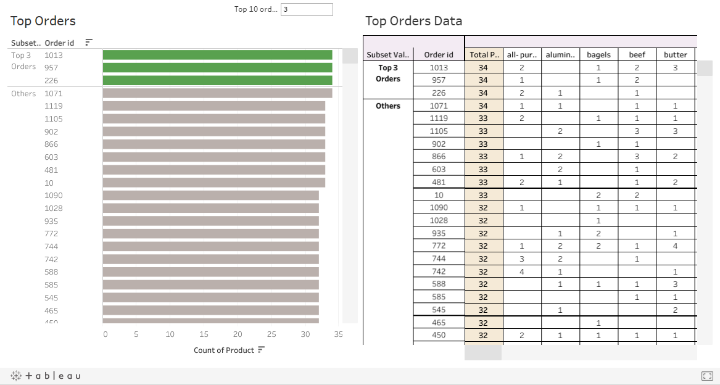

Slide 12
Data Analysis Inferences
There are a total of 1139 orders placed. Among them the top 3 orders are Order ID: 1013, 957 and 226 with a total of 34 products purchased.
The highest product that is purchased irrespective of order dates is poultry, followed by soda and cereals.
The least purchased item is the hand soaps.
The store is facing a decline in order on 2020, compared to the same time in the last 2 years.
The end of the week we see a raise in trend. Same cannot be said for the end on the month, there is a decrease.
There no record are there for Q4 are found for 2018 and 2019. However, the sales has been decreasing (negative trend) since 2018 (2018>2019>2020)

Slide 13
MBA Analysis Using KNIME Analysis

Slide 14
Market Basket Analysis
“Market Basket Analysis” is one of the best applications of machine learning in the retail industry. By analyzing the past purchase behavior of customers, we can find out which products are frequently bought together by the customers.
The disclosure of “Correlation Relationships” among huge amounts of transaction records can help in many decision-making processes, such as the design of catalogs, cross-marketing, and customer shopping Analysis
Association Rule for Market Basket Analysis are widely used to analyse retail basket, association between different objects in a set, find frequent patterns in a transaction database

Slide 15
Components of Market Basket Analysis
The Apriori algorithm is commonly used in research articles about market basket analysis. There are three components in Apriori algorithm:
Support: It is the ratio of transactions involving number of transaction of the item by the total number of transactions made.
Confidence: It is whether the product sales are popular on individual sales or through combined sales has been calculated.
Lift: It calculated for knowing the ratio for the sales. (confidence percent/ support percent).

Slide 16
KNIME MBA Workflow
I have used Python and Tableau for data read and EDA
In this project I have used, KNIME is used to perform the MBA.
Firstly after importing the data to KNIME, the data was grouped using order_id since there were multiple rows for a single order.
Next, using cell splitter a set of items were created for the further MBA Analysis.
Using Association Rule Learner, the product recommendations were given by setting support = 0.05 and confidence =0.60 for this dataset

Slide 17
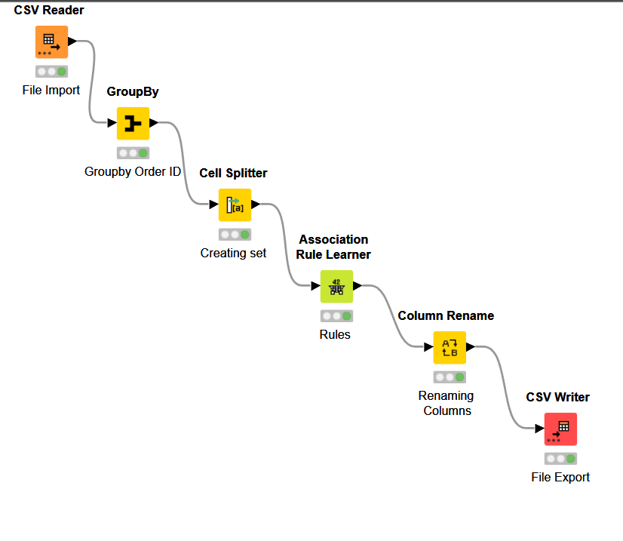
MBA Analysis Work Flow

Slide 18
MBA Output Data
Rules | Support | Confidence | Lift | Recommended Item | Items List
rule0 | 0.05004389816 | 0.6404494382 | 1.700400723 | juice | [yogurt, toilet paper, aluminum foil]
rule1 | 0.05004389816 | 0.6195652174 | 1.644952873 | juice | [yogurt, poultry, aluminum foil]
rule2 | 0.05004389816 | 0.6129032258 | 1.615964755 | coffee/tea | [yogurt, cheeses, cereals]
rule3 | 0.05004389816 | 0.6 | 1.42375 | poultry | [dishwashing liquid/detergent, laundry detergent, mixes]
rule4 | 0.05092186128 | 0.6304347826 | 1.677722471 | mixes | [yogurt, poultry, aluminum foil]
rule5 | 0.05092186128 | 0.6105263158 | 1.659640749 | sandwich bags | [cheeses, bagels, cereals]
rule6 | 0.05092186128 | 0.6744186047 | 1.726208518 | cheeses | [bagels, cereals, sandwich bags]
rule7 | 0.05092186128 | 0.6170212766 | 1.55828655 | cereals | [cheeses, bagels, sandwich bags]
rule8 | 0.05092186128 | 0.6304347826 | 1.620914712 | dinner rolls | [spaghetti sauce, poultry, cereals]
rule9 | 0.05092186128 | 0.6373626374 | 1.512408425 | poultry | [dinner rolls, spaghetti sauce, cereals]
rule10 | 0.05092186128 | 0.6041666667 | 1.589251347 | milk | [poultry, laundry detergent, cereals]
rule11 | 0.05179982441 | 0.6276595745 | 1.610144719 | eggs | [dinner rolls, poultry, soda]
rule12 | 0.05179982441 | 0.6413043478 | 1.648861517 | dinner rolls | [spaghetti sauce, poultry, ice cream]
rule13 | 0.05179982441 | 0.6860465116 | 1.627931202 | poultry | [dinner rolls, spaghetti sauce, ice cream]
rule14 | 0.05179982441 | 0.6276595745 | 1.613779357 | dinner rolls | [spaghetti sauce, poultry, juice]
rule15 | 0.05179982441 | 0.6020408163 | 1.428592687 | poultry | [dinner rolls, spaghetti sauce, juice]
rule16 | 0.05179982441 | 0.6344086022 | 1.627458103 | eggs | [paper towels, dinner rolls, pasta]
rule17 | 0.05179982441 | 0.6020408163 | 1.621098085 | pasta | [paper towels, eggs, dinner rolls]
rule18 | 0.05355575066 | 0.6421052632 | 1.650920756 | dinner rolls | [spaghetti sauce, poultry, laundry detergent]
rule19 | 0.05355575066 | 0.6559139785 | 1.556429211 | poultry | [dinner rolls, spaghetti sauce, laundry detergent]
rule20 | 0.05531167691 | 0.6237623762 | 1.564901644 | ice cream | [paper towels, eggs, pasta]
rule21 | 0.05531167691 | 0.63 | 1.616148649 | eggs | [paper towels, ice cream, pasta]
rule22 | 0.05531167691 | 0.6428571429 | 1.73100304 | pasta | [paper towels, eggs, ice cream]
rule23 | 0.05531167691 | 0.6494845361 | 1.79119343 | paper towels | [eggs, ice cream, pasta]

Slide 19
Inferences on MBA Analysis (1/2)
Support: The level of an item's popularity. The ratio of item A transactions to all transactions, expressed mathematically, is the support of item A.
The probability of ordering an item increases with its level of support.
Confidence: The likelihood that a consumer will purchase both A and B. It is calculated as the ratio of the number of transactions involving B to those involving A and vice versa.
A confidence of B equals support of A and B. (A)
The likelihood that the combination will work increases with probability.
Lift: When the sales of one product are positively impacted by the sales of another. When you sell B, your chances of selling A increase.
Confidence(A, B)/Support = Lift(A => B) (B)
There is no association within the itemset if Lift (A => B) = 1.

Slide 20
Inferences on MBA Analysis (2/2)
Lift (A => B) > 1 denotes a positive correlation inside the itemset, indicating that A and B are more likely to be purchased together than other items in the itemset.
Lift (A => B) <1 denotes a negative correlation inside the itemset, i.e., A and B's products are not likely to be purchased together.
Generally speaking, we would prefer Lift to be more than 1.
So, for this dataset, I have chosen the minimal support = 0.055 at the highest confidence level = 0.60.

Slide 21
Recommendations on MBA Analysis
The sandwich bag is placed between the Cheeses and the Bagels. Will increase sales of sandwich bags.
The most established rules for having poultry as a recommended commodity. This is also a best-selling item, creating combos with poultry will be very beneficial.
Introductory offer for new customers with a reward points system for the next purchase.
Orders are lower in the fourth quarter and year-end and season-end sales will be profitable during this period.
The advantage is that sales are seen at the beginning of the year, discounts or prices of limited-time events will be useful later in the year or on weekdays to drive sales.

Slide 22
Offers or Combos on MBA Analysis
10% discount on poultry purchased with sausages or dinner rolls
15% off hand soap when purchasing poultry.
Buy 1 get 1 free paper towel for eggs and ice cream.
Promotion of milk with cereals and cheese with bagels might be a good combo to be recommended.
Free spaghetti sauce with Dinner rolls + poultry + eggs combo.
Redemption point schemes for each purchase based on amount spent can be implemented.
Loyalty points to redeem at the end of the month/year for regular customer. This would improve the retention rate.
Apart from these, we might want to be vigilant to not lose customers and attract new customers by giving introductory offers like 5% off on first offer.

Slide 23
Thank You ☺

